Slide 1
Afro Disco
Maxim Srour, Zac Lucarelli and David Moore
Notes:
MAX Hey how you doin’?, we are Max, Zac and David and we’ll be talking about Afro Disco

Slide 2
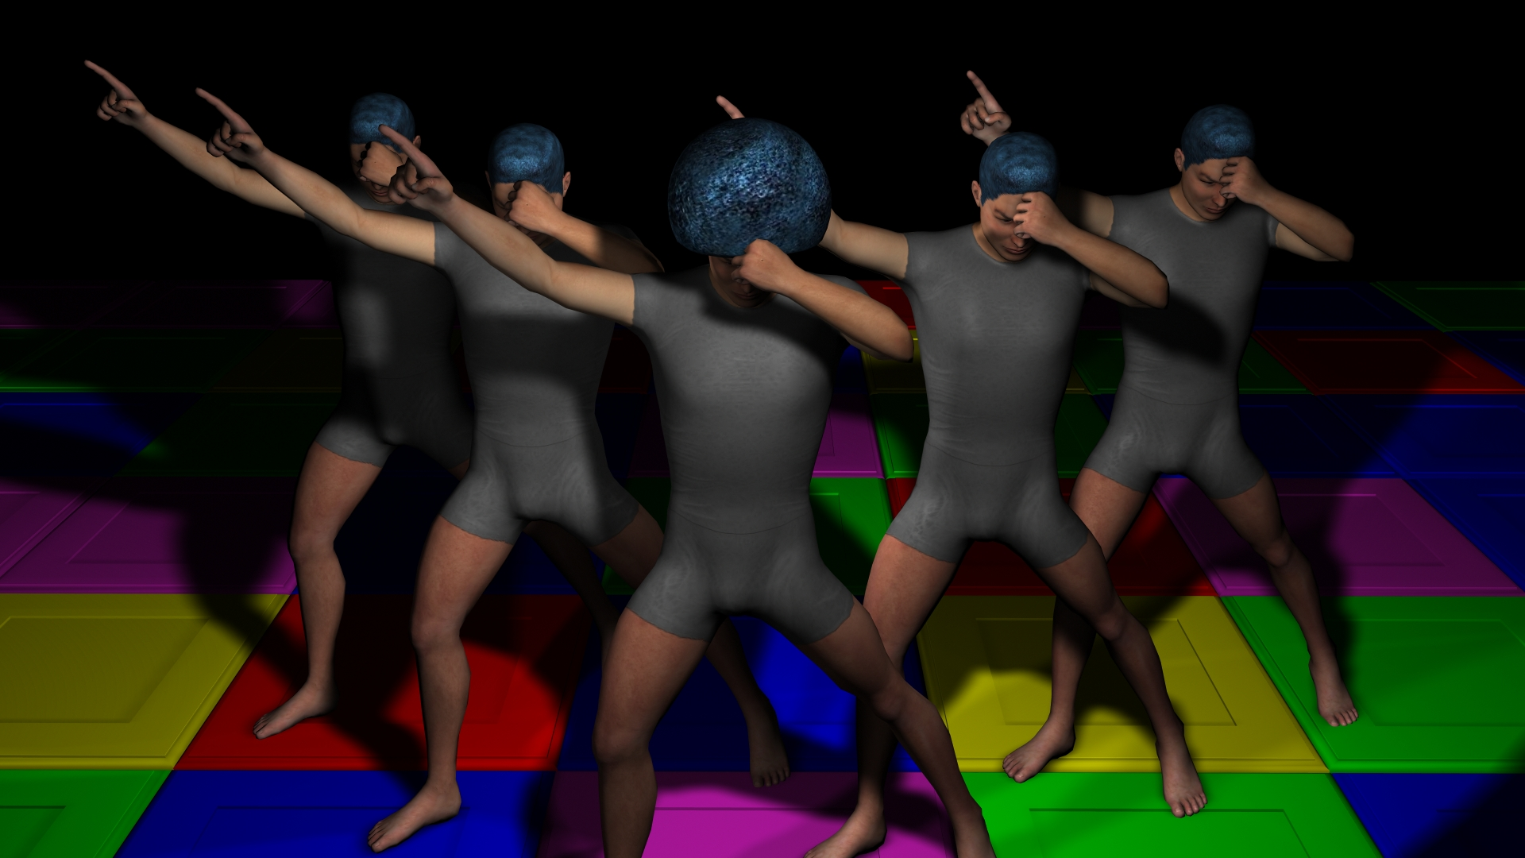
Dance your friends into submission in the game where chess meets Smash Brothers
Notes:
MAX (handoff to David) Thanks to Max for *that* visual
Are they dabbing????
Dab on the haters

Slide 3
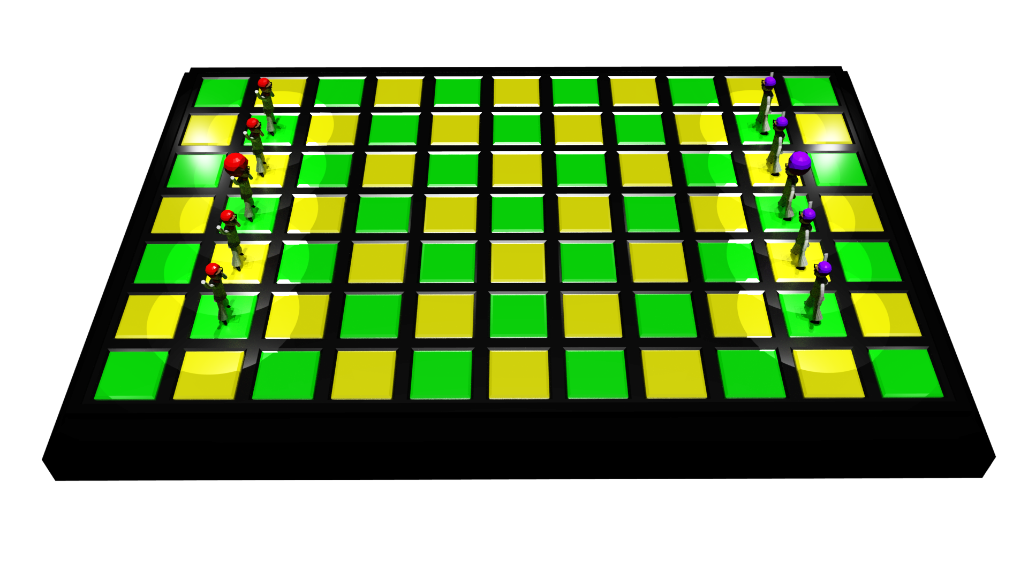
How it Works
Turn-based
7x11 grid
You have one Lead Dancer, four Backup Dancers
Each Dancer can move two spaces each turn
Perform Dance Moves at any time during your turn
Use Dance Moves to push your opponents off the Dance Floor!
Notes:
DAVID
Dance Moves require specific Dancer arrangements
Build your “deck” of Dance Moves before the game begins

Slide 4
Are you ready to dance?
Notes:
DAVID
So. Are you ready to dance?

Slide 5
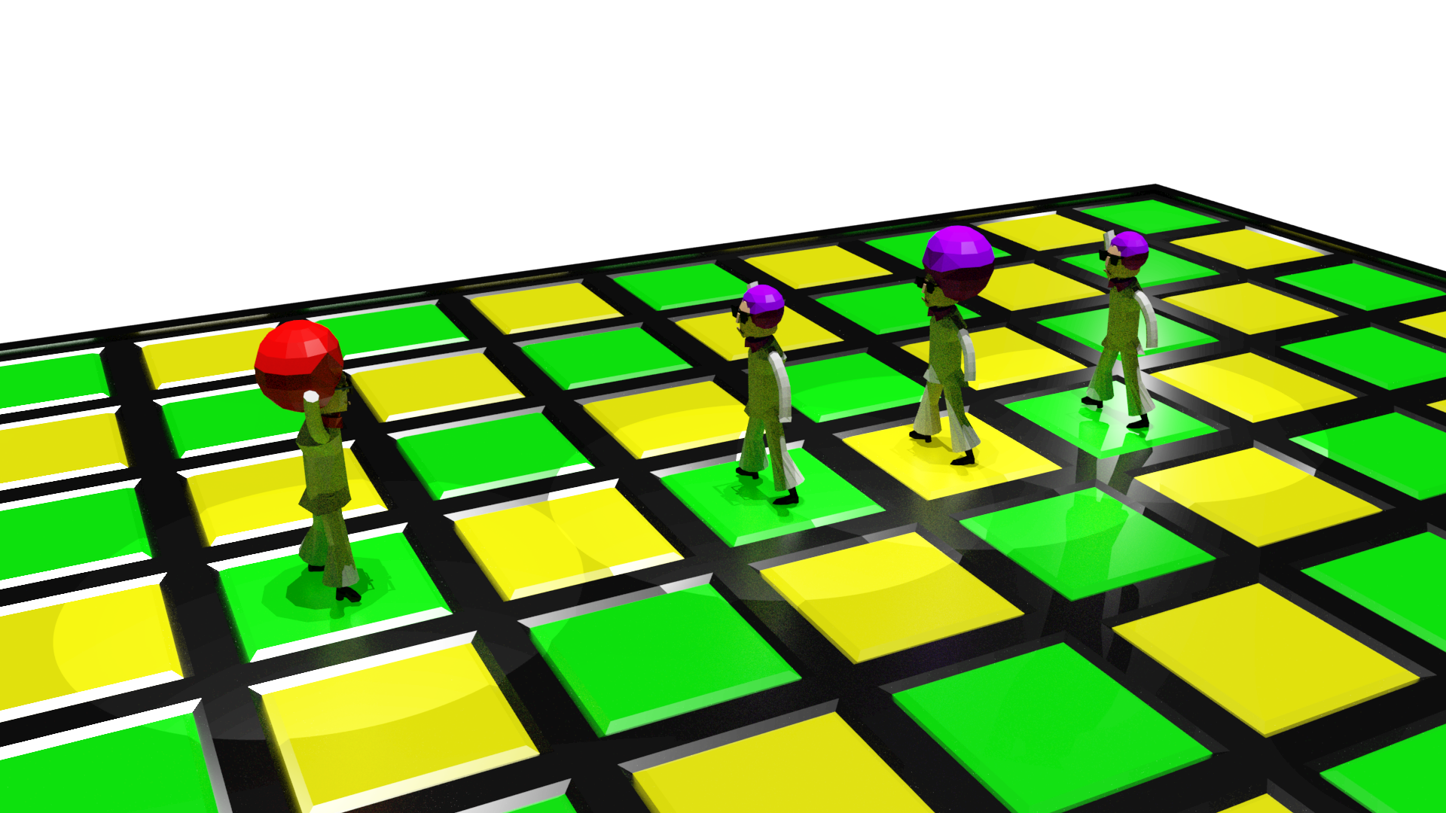
Dance Moves - Conga Line
Whoa whoa whoa… what’s a Dance Move?
A Dance Move is an arrangement of Dancers which lets your push other Dancers around
In a Conga Line, you line up and push back any opponents in line with you
Notes:
DAVID No yet? Okay, let’s get into a little more detail

Slide 6
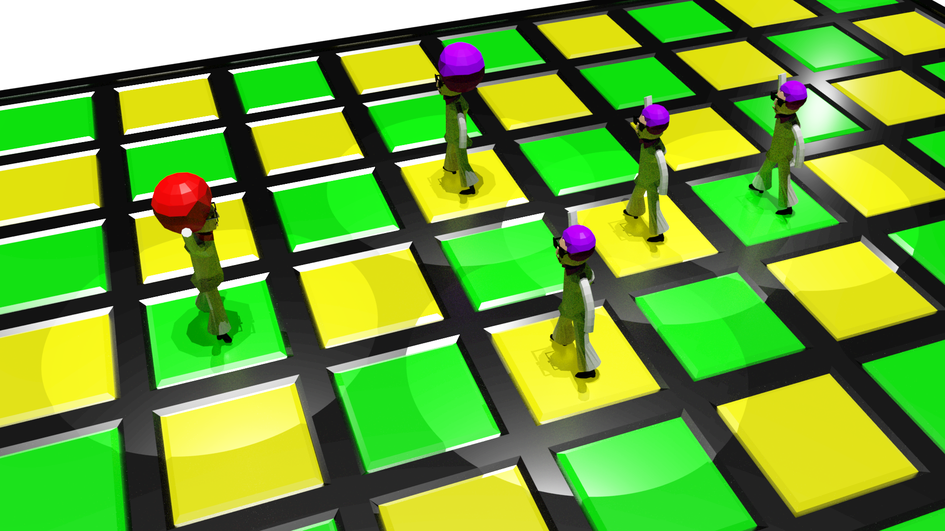
Dance Moves - Boogaloo
Moves can be more complicated
In a Boogaloo, you form a Y shape and shoot one enemy off at 90 degrees
Notes:
DAVID
Some Moves are a more complicated, the Boogaloo is pretty much the top end of that Oh, and of course it’s electric
BAZINGA

Slide 7
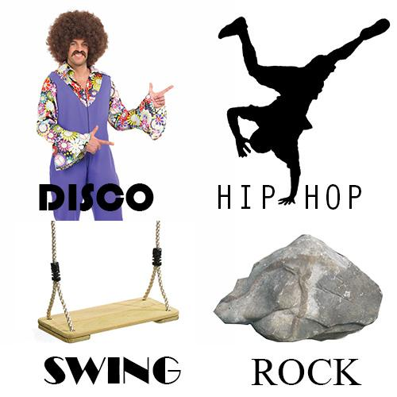
Eras
Moves are placed into Eras
Each Era has a mechanical theme
Players can only use Moves from one Era during a match
Notes:
DAVID (hand off to Max) We’re grouping the moves into Eras, and players only get to use one Era plus the generalist Pop Era when picking their Moves for a game
Each Era has a mechanical throughline, for example, the Rock Era has moves which push your own Dancers around
And now to go over the advantages of the design, here’s Max

Slide 8
So that's what.
Here is why
Notes:
MAX
So now you know what afro disco is,
Now we'll discuss the reasoning for the design

Slide 9
Easy to Play, Difficult to Master
Easy to read gamestate
No health bars
No obscured mechanics
Depth through customizability
Only ever deal with a small number of moves in a match
Turn based
Gives you time to think
Just like real dancing
But with less muscle strain
Notes:
MAX Make it clear that Just Like Real Dancing is a joke

Slide 10
But what about actually selling it!?
Notes:
MAX Well I’m glad you asked!

Slide 11
Targeting the Audience
Target market: People who want to play tactics games but have bounced off
Age: Mid teens - late thirties
Gender: More female than male
Reasons for bouncing off tactics games:
Not enough time
Not interested in strategy layer
Don’t like violent/warlike themes
Too much complexity
Steep learning curve
Notes:
MAX

Slide 12
How we’re hitting that target
Not enough time: Short rounds, easy to put down in between
Not interested in strategy layer: No strategy layer except choosing Moves
Don’t like violent/warlike themes: It’s a dance off instead!
Too much complexity: Minimal systems, no hidden information
Steep learning curve: Focus on onboarding experience
Notes:
MAX (handoff to Zac)

Slide 13




Platforms and Technology
Engine:
Unity
Platforms:
Android
Windows PC
iOS
Notes:
ZAC
Afro Disco will be made in Unity
There are three platforms we would like to hit, but only if each previous one was promising
First target platform: Android
Low developer fee
Mobile: good for our target market
Large install base
Second: Windows PC
If Android is at all successful
Low developer fee
PC: fairly good for our target market
Distribution via itch.io
Third: iOS
If other platforms are fairly successful
Moderate developer fee
Mobile: good for our target market

Slide 14
Going to Market
Marketing
Gifs on Reddit and Twitter!
Cool Tweets!
Calls to action when the game is released
Integrated analytics - responding to player action + needs
Monetization
Ad supported, free to play locally
One off purchase to unlock online multiplayer and remove ads
Notes:
ZAC

Slide 15
Milestones
19th September: MVP
17th October: Second Milestone
All core art assets
One full Era, and all neutral Dance Moves
3rd November: Project Submission / Third Milestone
Sound assets
Tutorials/onboarding
Second full Era of Moves
Trailer
Q1 2018: Android Release
All Moves
Polish
Notes:
ZAC
Mention hoping to come back to Firemonkeys with the Third Milestone build

Slide 16
Follow us for updates!
@AfroDiscoGame
Personal Twitters:
David @EqualzDee
Max @MaximSrour
Zac @Chikanz
Notes:
ZAC
So, thank you all for your time, and we’re open for questions
[Leave this slide up on screen during the questions unless we specifically need to show a different one]

